Slide 1
The week 11 interim interview presentation on HECC-IT
Hypertext Editing and Creation Code Integrated Toolkit
A toolkit for making hypertext games
by Rachel Lowe

Slide 2
What is a hypertext game?
tl;dr: Stories but they aren’t linear
Not as in ‘unreliable narrator’ nonlinear, but as in ‘hmm do I go to the left or to the right’ nonlinear
Ergodic Literature
Some examples you may know about
‘Choose your own adventure’ books
Black Mirror – Bandersnatch
Both the game itself and the fictional game in the game
The World Wide Web (albeit that’s not really a game)
Here’s one I made earlier

Slide 3
Why make a tool to make hypertext games?
Makes it easier to write them
Writing raw HTML is a pain
Writing raw JavaScript is also a pain
Less time spent faffing = more time spent making a competent game
Less confusing
Helps if you can visualize how each ‘passage’ is linked
If you’re making something non-linear, it helps if you can see it non-linearly
Reusability
And others can use it too

Slide 4
Why am I doing this project
It looked interesting
Making a thing that others can make things with
Might actually be of some use to someone!
Nice change of pace from everything else
Art reasons
You ever just make a game for the sole purpose of getting stuff off your chest
I’m a systems-oriented sort of person, not a traditional art sort of person.
Logistics
Doesn’t require specialised hardware/software

Slide 5
The design goals
Make a tool for people who are indecisive.
Most existing tools are either 100% raw code or 100% GUI
Some allow users to use raw code and/or a GUI, but those usually come with a caveat
HECC-IT solves this problem
User can write .hecc code or use the OH-HECC GUI to help them write it
User can use HECC-UP to convert a .hecc file into a playable game
Make the games easy to play (from a technical perspective)
Browser-based, 100% clientside, HTML/JavaScript
If people can’t use the outputs, what’s the point?
Follow the Treaty of Babel standard for Interactive Fiction Bibliography
tl;dr this specifies metadata etc for identifying/archiving works of interactive fiction
So it’s more legit
Notes:
Make a tool for people who are indecisive.
Most existing tools are either 100% text-based (inform, squiffy, undum, etc) or 100% GUI-based (storyspace, twine, TADS, etc)
Some tools almost allow both, but awkwardly
Can convert twee code to twine, awkward to decompile (especially on Windows)
Inklewriter to/from .ink code: really longwinded
HECC-IT solves this problem
User can write .hecc code or use the OH-HECC GUI to help them write it
User can use HECC-UP to convert .hecc into a game
Make the games easy (technically) to play
Browser-based, 100% clientside, HTML/JavaScript
If people can’t use the outputs, what’s the point?
Follow the Treaty of Babel standard for Interactive Fiction Bibliography
Metadata etc
So it’s more legit

Slide 6
The Objectives for the MVP
Create a system for playing hypertext games via a web browser
The HECCIN Game
Establish a language that can be used to define hypertext games
HECC
Create a utility that can parse that intermediate code into a playable hypertext game
HECC-UP
I could have stopped here for the MVP.
But I wanted the MVP to be viable.
Create a GUI program that can make that intermediate code
OH-HECC
Notes:
I could have just stopped after HECC-UP.
But I didn’t.
Because I wanted this MVP to be Viable.

Slide 7
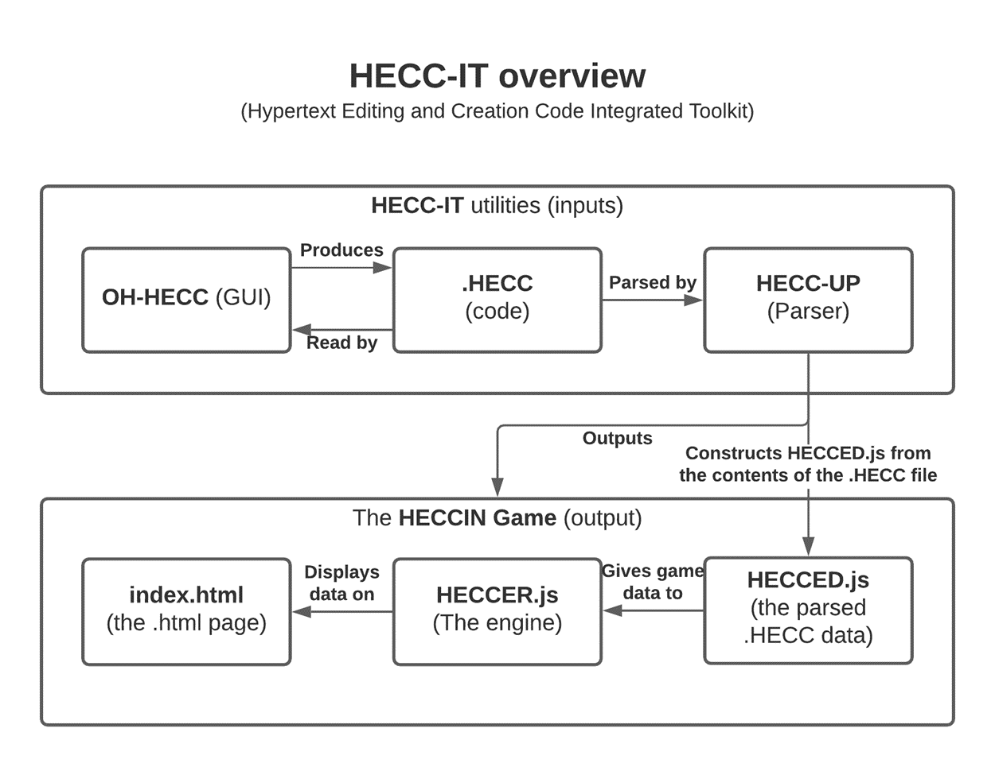
How everything fits together

Slide 8
The .hecc language (Hypertext Editing and Creation Code)
Syntax is very similar to that of Twee and Squiffy
De-facto standards, familiarity for people who already use those
Defined in the HECC-SPECC
HECC Super Precise Explanation for Creating Code
Has metadata
Author, game title, comments, start passage, IFID
Can define passages
Passage names, position in OH-HECC, tags, comments, and content
Passages also hold links to other passages

Slide 9

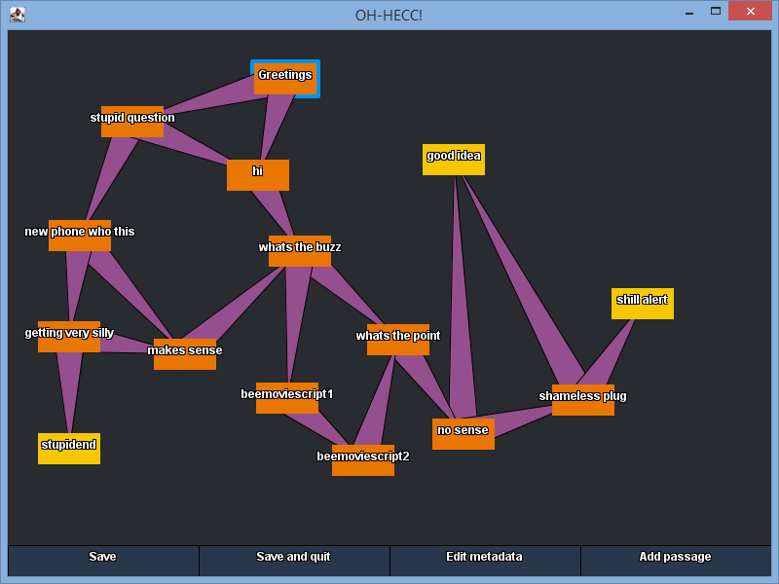
OH-HECC (Optional Help for HECC)
GUI for editing HECC
Can open existing .hecc files or make and edit a new .hecc file
Similar in functionality to Twine
Network of connected passages
Easy to add/edit/remove passages
Can edit metadata
Namesake was said several times whilst developing it.
Users hopefully won’t find themselves saying it

Slide 10
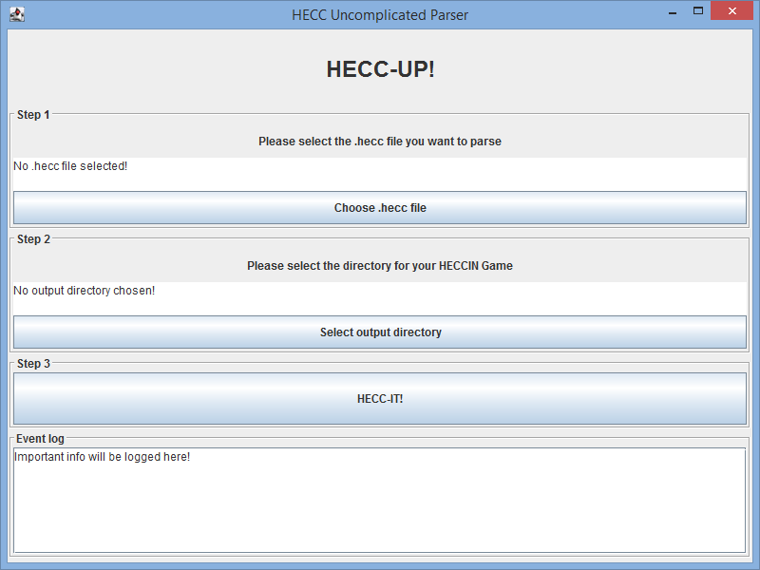
HECC-UP (HECC Uncomplicated Parser)
Give it a .hecc file and a location to save a HECCIN Game to
It’ll use that .hecc file to make a HECCIN Game.
And it’ll open it so you can playtest it!
If there’s a problem with your .hecc file, it will complain.
And it’ll tell you what caused the HECC-UP!

Slide 11

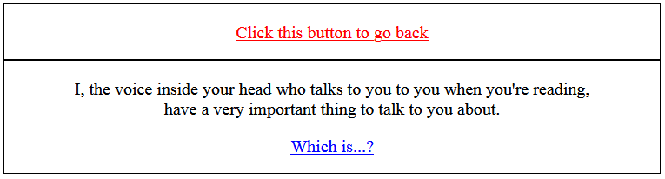
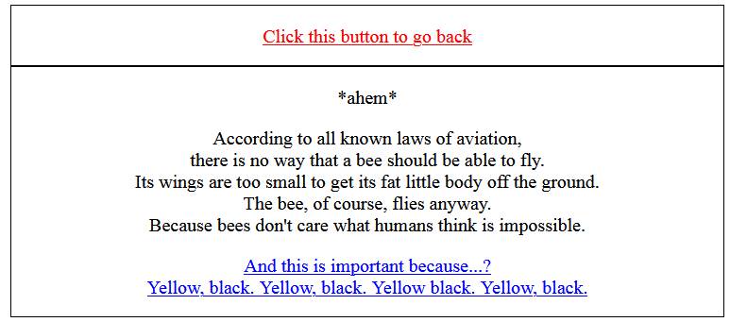
HECCIN Game (HECC-Infused Nice Game)
A hypertext game output by HECC-UP.
The game from earlier on is one of these.
3 components
Index.html
Baked into HECC-UP, players see this.
heccer.js
HECC Environment for Runtime
Baked into HECC-UP, finite state machine for the passages
hecced.js
HECC Exported Data
Generated from the .hecc code, gives passage data to the heccer.

Slide 12
The parts that didn’t go well
Attempted to add markdown formatting during challenge week
Put on the backburner until after the MVP
A mix of perfectionism and also laziness with the code
Delayed moving onto OH-HECC until several weeks after I made HECC-UP, due to quite a bit of refactoring of it
But that refactoring only was needed in the first place due to a few errors made when making it the first time
The ‘game’ part of the project brief
Yeah that’s not really here yet

Slide 13
Usage of Jira
~280 hours in total logged on Jira (as of 16/12/2020)
Splitting big tasks into subtasks
Although, for OH-HECC, I forgot to mark the first subtask as done and I accidentally logged all the work for that under one singular subtask
Some use of releases
Summer prep work was filed away into a release
Challenge Week work was filed away into a release
This term’s work will be filed away into a release too
Bugs/risks etc reported on Jira as well
Informal ‘sprints’ between supervisory meetings
Haven’t used stories/story points/estimated times
Have used epics though
Notes:
Time tracking reports:
No release (the current one as of time of writing): https://cseejira.essex.ac.uk/secure/ConfigureReport.jspa?versionId=-1&sortingOrder=least&completedFilter=all&subtaskInclusion=onlySelected&selectedProjectId=15147&reportKey=com.atlassian.jira.jira-core-reports-plugin%3Atime-tracking&atl_token=B9HA-A75A-1MQD-BVTB_5869a7026a3445598fb9ec8069105d10dc2c78a4_lin&Next=Next
If that one is empty, generate a new one with the ‘MVP’ fix version selected here: https://cseejira.essex.ac.uk/secure/ConfigureReport!default.jspa?selectedProjectId=15147&projectOrFilterId=project-15147&projectOrFilterName=ce301_lowe_richard_m&reportKey=com.atlassian.jira.jira-core-reports-plugin:time-tracking
Challenge Week: https://cseejira.essex.ac.uk/secure/ConfigureReport.jspa?versionId=14131&sortingOrder=least&completedFilter=all&subtaskInclusion=onlySelected&selectedProjectId=15147&reportKey=com.atlassian.jira.jira-core-reports-plugin%3Atime-tracking&atl_token=B9HA-A75A-1MQD-BVTB_5869a7026a3445598fb9ec8069105d10dc2c78a4_lin&Next=Next
Summer: https://cseejira.essex.ac.uk/secure/ConfigureReport.jspa?versionId=14012&sortingOrder=least&completedFilter=all&subtaskInclusion=onlySelected&selectedProjectId=15147&reportKey=com.atlassian.jira.jira-core-reports-plugin%3Atime-tracking&atl_token=B9HA-A75A-1MQD-BVTB_5869a7026a3445598fb9ec8069105d10dc2c78a4_lin&Next=Next

Slide 14
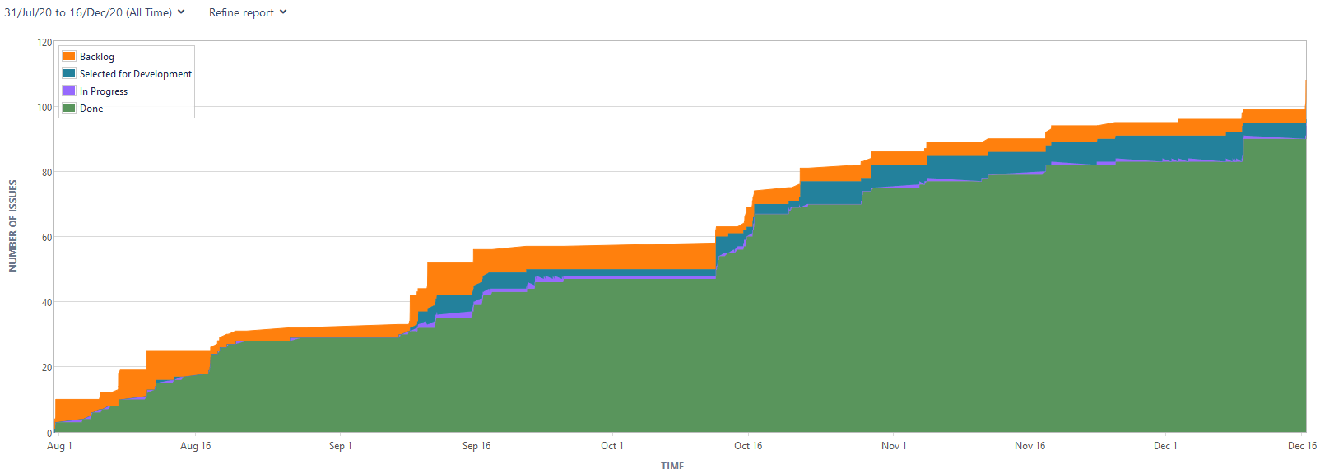
Cumulative Flow Diagram

Slide 15
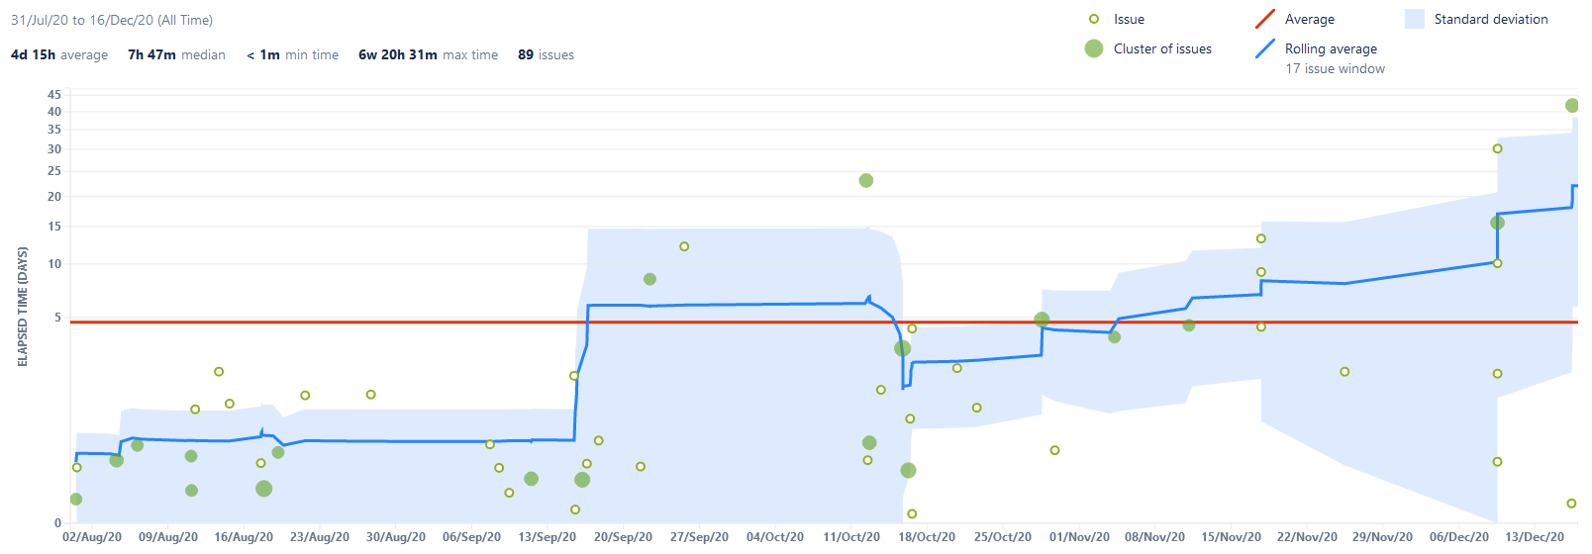
Control Chart

Slide 16
Usage of gitlab
Everything is on my gitlab repo
155 commits as of 16/12/20
I do a thing? I commit it.
Technical documentation for source code is available on the repo
See the ‘Technical Documentation’ folder
(auto-generated via Javadoc comments in the source code)
Used branches as archives of the project at certain points in time
End of summer, end of challenge week, will make another after this term, etc.
There’s also a downloadable version of HECC-IT on there as well
.jar for both bits, HECC-SPECC, readme + license, and some sample hecc files

Slide 17
Next Steps
Incorporate HECC-UP and OH-HECC into a single program
Easier for users to export their games, not bamboozling on the ‘Integrated’
Add markdown formatting support to the output
Add guard conditions into the output
Some more usability features in OH-HECC
Search for passages by name/by tag/etc
General idiotproofing
Actually make a proper HECCIN game with HECC-IT.

Slide 18
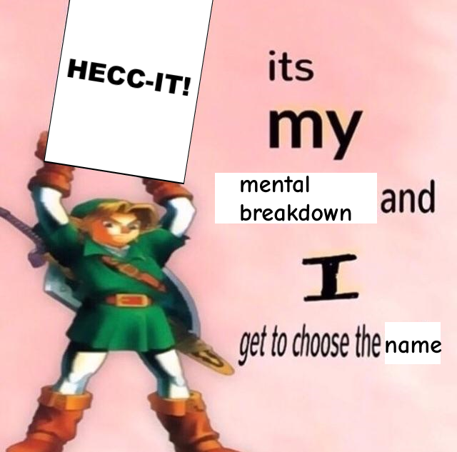
Why is it called HECC-IT?
Notes:
Template from https://www.reddit.com/r/dankmemes/comments/7y5wgb/mine/

